Slide 1

Design and implementation of Online Notes Sharing Platform
Dr.Moorthy
Dr.Arul Raj
DONE BY
HASHINATH M
SUBASH E

Slide 2
AIM AND OBJECTIVE
Enable users to upload, categorize, and manage notes in various formats (PDF, DOC, PPT, etc.).
Allow users to browse, search, filter by subject or tags and download notes easily.
Provide user authentication (login/register) to manage permissions and protect content integrity.
Offer a clean, responsive, and user-friendly interface with features like progress bars, previews, and image thumbnails.
Maintain security and data-integrity, ensuring files are stored safely, downloads are authorized, and the system is scalable.

Slide 3
ABSTRACT
Provides a platform for users to upload, share, and manage academic notes in multiple file formats.
Enables browsing, searching, and filtering by subject, tags, and keywords for easy discovery.
Supports secure user authentication to control uploads and protect content integrity.
Incorporates animated, responsive UI elements and file download features for better user experience.
Aims to facilitate collaborative learning by making study resources accessible and reducing duplication.

Slide 4
LITERATURE REVIEW
Author / Year | Title / Study | Objective | Methodology / Technology Used | Findings / Conclusion
Smith, 2020 | Online Educational Resources | To study the impact of online resources on learning | Survey and online platform analysis | Online notes improve student performance and accessibility
Lee & Kim, 2019 | Digital Note Sharing Systems | To analyze digital note-sharing platforms | Case study of existing platforms | Sharing notes online enhances collaboration and reduces resource gaps
Patel, 2021 | Cloud-based Learning Tools | To explore cloud solutions for education | Implementation of cloud storage and web apps | Cloud-based platforms allow easy upload, download, and access from anywhere
Johnson, 2018 | Student Collaboration Tools | To improve academic collaboration | Design and testing of a prototype system | Online sharing platforms increase engagement and learning efficiency
Gupta & Rao, 2022 | E-Learning Note Management | To study features of note management systems | Comparative analysis of software tools | Effective categorization, search, and download features are crucial for usability

Slide 5
PROBLEM STATEMENT
Students often lack a centralized platform to upload and retrieve academic notes, resulting in scattered resources.
Shared notes via informal channels (WhatsApp, email) are hard to organize or search by subject and tags.
Without proper authentication, uploaded content may be misused, lost, or accessed by unauthorized users.
Inadequate download mechanisms and metadata (no titles, tags, or download links) make accessing the right notes slow and inefficient.

Slide 6
EXISTING SYSTEM
Many existing platforms allow basic note storage and sharing but lack advanced filtering or tagging by subject/tags.
Often there is limited or no download support for uploaded notes, or irregular control over who can download.
Security, privacy, and access control can be weak; for example, insufficient authentication or unauthorized access risks.
Interfaces may be less user-friendly, especially for searching, browsing, or organizing many notes; poor UX and inconsistent device compatibility.

Slide 7
PROPOSED SYSTEM
Allow users to register, login and manage their profiles securely, enabling role-based access (e.g. student, teacher, admin).
Provide a robust note upload mechanism (support for PDF, DOCX, etc.) with metadata (title, subject, tags) and file preview.
Enable browsing, searching and filtering of notes by subject, tags, keywords, and display thumbnails or images for better UI.
Implement reliable download functionality — each note card has a download link or button; files served with correct HTTP headers to force download.
Include UX improvements: responsive design, animations for uploading/downloading, progress indicators, and a clean, intuitive interface.

Slide 8
REQUIRED ANALYSIS
2. Hardware Requirements (Points)
Server-Side:
Processor: Intel i5/i7 or AMD Ryzen 5/7
RAM: Minimum 8 GB (16 GB recommended)
Storage: Minimum 500 GB HDD/SSD (SSD preferred)
High-speed internet connection (100 Mbps or higher)
Backup storage: External or cloud
Client-Side:
6. Processor: Intel i3 or equivalent
7. RAM: Minimum 4 GB
8. Storage: At least 100 MB free space
9. Internet: Broadband connection (10 Mbps or higher)
10. Device: PC, Laptop, or Mobile with modern browser
1. Software Requirements (Points)
Frontend: HTML5, CSS3, JavaScript
Frontend framework: React.js / Angular / Vue.js
Responsive design: Bootstrap or Tailwind CSS
Backend: Python (Django/Flask) or Node.js (Express)
Web server: Apache or Nginx
Database: MySQL / PostgreSQL (optional: MongoDB)
Version control: Git
IDE: VS Code, PyCharm, or similar
Secure communication: SSL/TLS
Authentication: JWT / OAuth
Browser support: Latest Chrome, Firefox, Edge

Slide 9
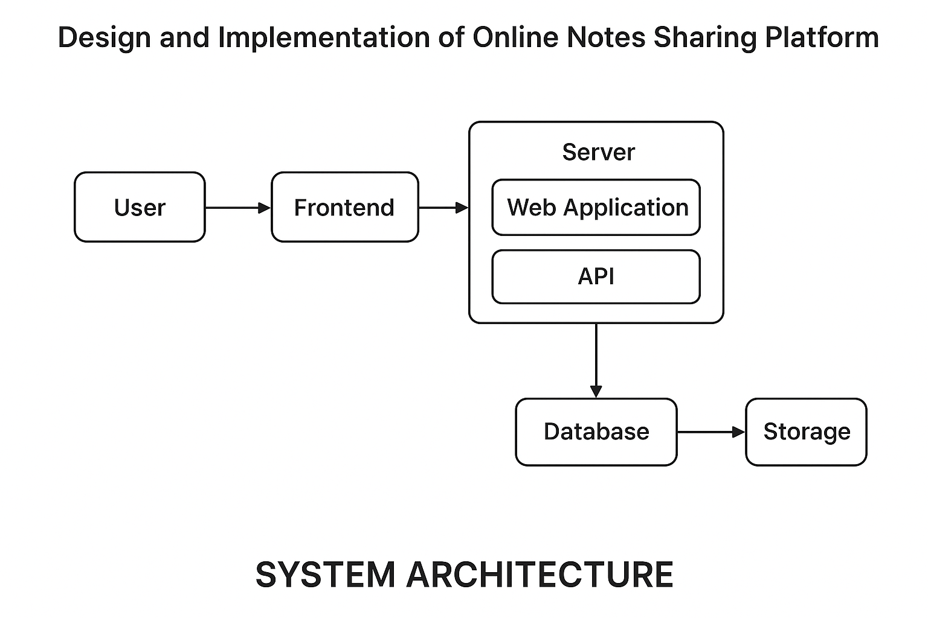
SYSTEM ARCHITECTURE

Slide 10
DESIGN AND MODULE PLANING
1. Search & Filter Module
Keyword-based search
Filter by subject, class, author, or upload date
Display results with previews or summaries
2. Download & Access Module
Download notes securely
Track download counts
Set permissions (public or restricted access)

Slide 11
MODULE 1-DEVELOPMENT OF SEARCH AND FILTER
Keyword-based search for notes
Filter by subject, class/grade, author, and upload date
Display results with title, author, subject, and download option
Pagination or infinite scroll for large data
Backend API to handle search and filters
Frontend UI with search box and filter options
Database indexing for faster search

Slide 12
MODULE 1-METHODOLOGY
Requirement analysis of user needs and system specifications
System and database design for platform architecture
Development of all modules (User, Notes, Search, Download, Feedback, Admin, Notifications)
Integration of frontend, backend, and database
Testing: unit, integration, and user acceptance
Deployment on server with security and backup
Maintenance and updates based on feedback

Slide 13
MODULE 1-SYSTEM DESIGN
Design overall platform architecture (frontend, backend, database)
Define database schema for users, notes, and categories
Create UI/UX layout for search, upload, and download pages
Design API endpoints for data communication between frontend and backend
Implement security measures (authentication, authorization, SSL)

Slide 14
MODULE 1-TESTING AND REVIEW
Conduct integration testing to ensure all modules work together seamlessly
Execute system testing to check overall functionality and performance
Perform user acceptance testing (UAT) with sample users for usability feedback
Identify and fix bugs and errors detected during testing
Review system for security, reliability, and efficiency

Slide 15
Module 2-Download & Access Module
The Download & Access Module allows users to easily access and retrieve shared notes from the platform.
It provides options for viewing, previewing, and downloading academic materials in different formats.
The module ensures secure access — only registered or authorized users can download notes.
It connects with the backend database and storage to fetch and deliver files efficiently.
The system maintains data integrity and prevents unauthorized downloads.

Slide 16
Module 2-Methgodology
User logs in to the system using valid credentials.
The user searches and selects the desired notes for download.
The frontend sends a download request to the server.
The server verifies the user’s authentication and access rights.
The system retrieves file details from the database.

Slide 17
Module 2- System design
The user interacts with the system through a web-based frontend interface.
The frontend sends requests (upload, search, download) to the server.
The server acts as a bridge between the user and the backend systems.
The application layer processes user requests and applies access control.
The database stores user data, file information, and activity logs.

Slide 18
Module 2-testing and integration with Module 1
Each module of the system is tested individually to ensure correct functionality.
The Upload Module is tested for file format validation and successful storage.
The Search and Filter Module is tested for accurate and relevant search results.
The Download & Access Module is tested for proper file retrieval and secure downloads.
The User Authentication Module is tested for valid login, registration, and access control.

Slide 19
System debugging and optimization
Start
Initiate the debugging and optimization process.
Collect Logs
Gather system logs and error reports from the platform.
Analyze Errors
Examine logs to identify issues, performance bottlenecks, or bugs.
Identify Problem
Pinpoint the root cause of system malfunctions or inefficiencies.
Implement Fix
Develop and apply solutions to address the identified problems.

Slide 20
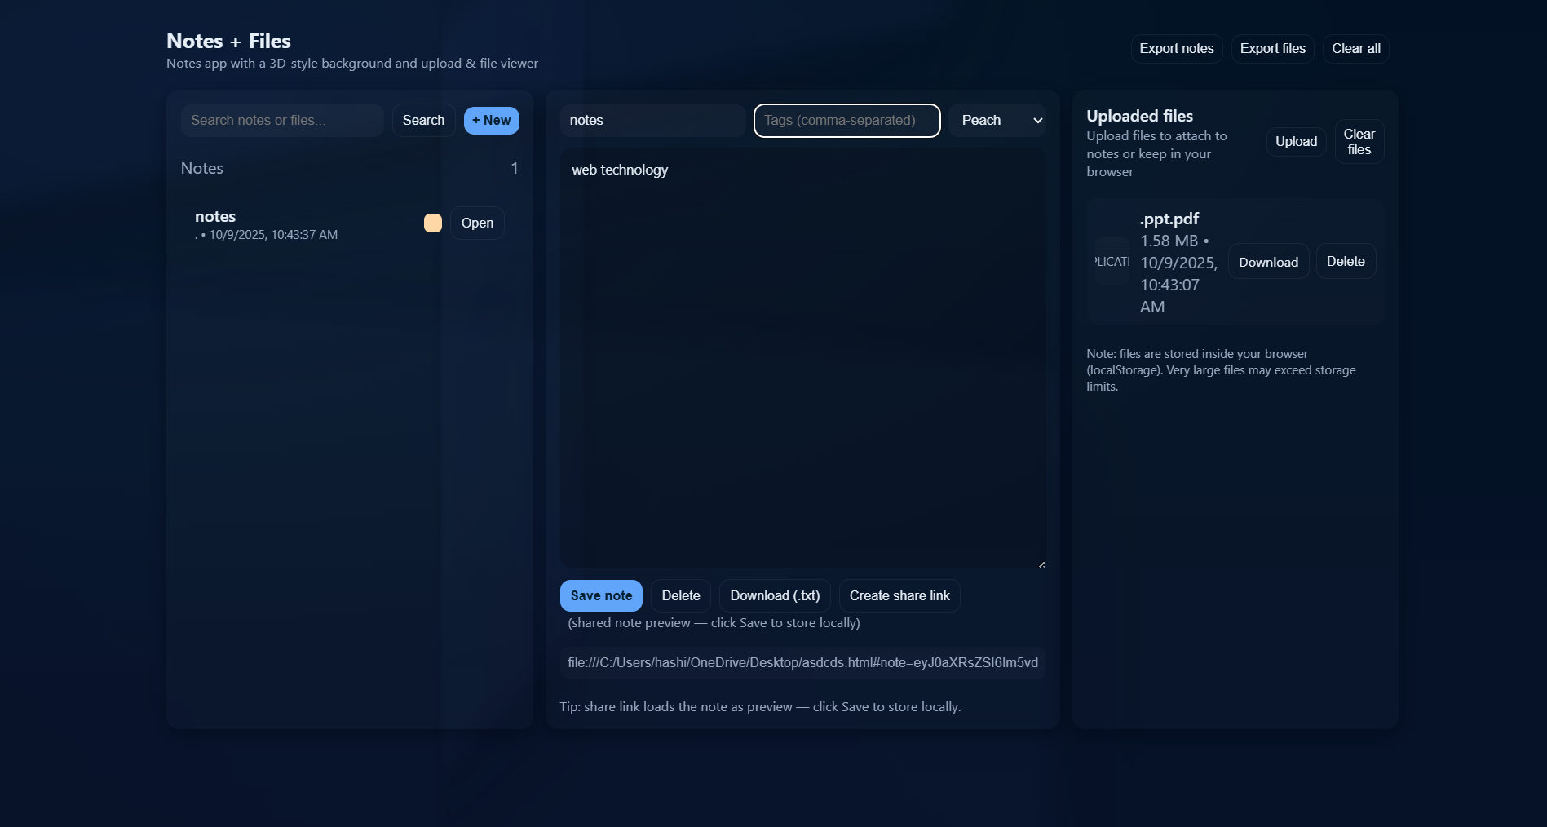
IMPLEMENTATION AND RESULTS

Slide 21
CONCLUSION
Structured debugging improves issue resolution.
Log analysis helps identify errors and performance issues.
Implementing timely fixes reduces system downtime.
System testing ensures fixes are effective and stable.
Continuous monitoring maintains performance and reliability.

Slide 22
Reference
Pressman, R. S., & Maxim, B. R. (2020). Software Engineering: A Practitioner’s Approach (9th ed.). McGraw-Hill Education.
→ Used for understanding the software development life cycle and implementation methodology.
Sommerville, I. (2015). Software Engineering (10th ed.). Pearson Education.
→ Provided insights into system design principles, software standards, and development frameworks.
W3Schools. (2024). HTML, CSS, and JavaScript Tutorials. Retrieved from https://www.w3schools.com
→ Used for developing and styling the web interface for the note-sharing platform.
Oracle Corporation. (2023). Java Platform, Standard Edition Documentation. Retrieved from https://docs.oracle.com/javase
→ Referenced for backend programming and servlet-based implementation.
MySQL Documentation. (2023). MySQL Reference Manual. Retrieved from https://dev.mysql.com/doc/
→ Used for database schema design, data storage, and retrieval processes.

Slide 23
THANK
YOU

